Slide 1
Assembly Language for x86 Processors 7th Edition
Kip Irvine
Chapter 2: x86 Processor Architecture
Dr. Isaac Ghansah
Revision date: 4/18/21
(c) Pearson Education, 2015. All rights reserved. You may modify and copy this slide show for your personal use, or for use in the classroom, as long as this copyright statement, the author's name, and the title are not changed.

Slide 2
Chapter Overview
General Concepts
IA-32 Processor Architecture
IA-32 Memory Management
64-bit Processors
Components of an IA-32 Microcomputer
Input-Output System

Slide 3
Intel Microprocessor History
IA-16 processor family (Intel 8086)
IA-16 processor family (Intel 80286)
IA-32 processor family (Intel 80386, 80387)
IA-32 processor family (Intel 80486)
IA-32 processor family (Intel 80586, Pentium)
P6 processor family (Intel Pentium)
CISC and RISC

Slide 4
Early Intel Microprocessors
Intel 8080
64K addressable RAM
8-bit registers
CP/M operating system
S-100 BUS architecture
8-inch floppy disks!
Intel 8086/8088
IBM-PC Used 8088
1 MB addressable RAM
16-bit registers
16-bit data bus (8-bit for 8088)
separate floating-point unit (8087)

Slide 5
The IBM-AT
Intel 80286
16 MB addressable RAM
Protected memory
several times faster than 8086
introduced IDE bus architecture
80287 floating point unit

Slide 6
Intel IA-32 Family
Intel386
4 GB addressable RAM, 32-bit registers, paging (virtual memory)
Intel486
instruction pipelining
Pentium
superscalar, 32-bit address bus, 64-bit internal data path

Slide 7
Intel P6 Family
Pentium Pro
advanced optimization techniques in microcode
Pentium II
MMX (multimedia) instruction set
Pentium III
SIMD (streaming extensions) instructions
Pentium 4 and Xeon
Intel NetBurst micro-architecture, tuned for multimedia

Slide 8
Detailed History of Intel Microprocessors
https://en.wikipedia.org/wiki/List_of_Intel_microprocessors

Slide 9
CISC and RISC
CISC – complex instruction set computer
large instruction set
high-level operations
requires microcode interpreter
examples: Intel 80x86 family
RISC – reduced instruction set computer
simple, atomic instructions
small instruction set
directly executed by hardware
examples:
ARM (Advanced RISC Machines)
DEC Alpha (now Compaq)

Slide 10
General Concepts
Basic microcomputer design
Instruction execution cycle
Reading from memory
How programs run

Slide 11
Basic Microcomputer Design
clock synchronizes CPU operations
control unit (CU) coordinates sequence of execution steps
ALU performs arithmetic and bitwise processing
Memory contains both instructions (code) and data
Special Register Program Counter (PC) contains address to next instruction. It is placed on the address bus to fetch instruction.

Slide 12
Clock
synchronizes all CPU and BUS operations
machine (clock) cycle measures time of a single operation. 1 Cycle time (Hz) = 1/clock speed (sec).
clock is used to trigger events
CPU speed is a function of clock speed.

Slide 13
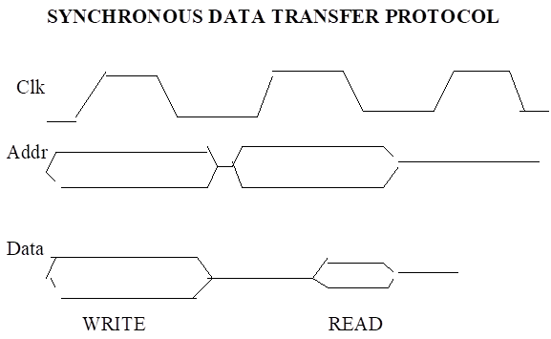
Memory and Access (Read/Write

Slide 14
What's Next
General Concepts
IA-32 Processor Architecture
IA-32 Memory Management
64-Bit Processors
Components of an IA-32 Microcomputer
Input-Output System

Slide 15
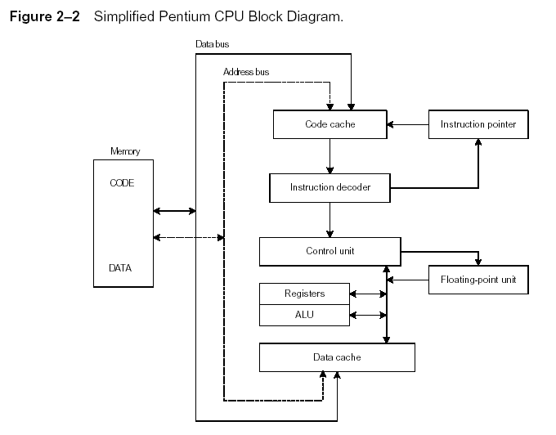
Instruction Execution Cycle
Instruction Execution Cycle
Fetch
Decode
Fetch operands
Execute
Store output

Slide 16
Reading from Memory
Multiple machine cycles are required when reading from memory, because it responds much more slowly than the CPU. The steps are:
Place the address of the value you want to read on the address bus.
Assert (changing the value of) the processor’s RD (read) pin.
Wait one clock cycle for the memory chips to respond.
Copy the data from the data bus into the destination operand
NOTE: This is the reason why we want to avoid reading from memory if we can. Eg. Fewer instructions, more instructions executed inside CPU etc is better.

Slide 17
Components of an IA-32 Microcomputer
Motherboard
Video output
Memory
Input-output ports

Slide 18
Motherboard
CPU socket
External cache memory slots
Main memory slots
BIOS chips
Sound synthesizer chip (optional)
Video controller chip (optional)
IDE, parallel, serial, USB, video, keyboard, joystick, network, and mouse connectors
PCI bus connectors (expansion cards)

Slide 19
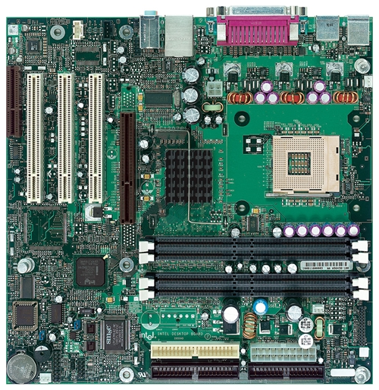
Intel D850MD Motherboard
mouse, keyboard, parallel, serial, and USB connectors
Video
Audio chip
PCI slots
memory controller hub
Pentium 4 socket
AGP slot
dynamic RAM
Firmware hub
I/O Controller
Speaker
Power connector
Battery
Diskette connector
Source: Intel® Desktop Board D850MD/D850MV Technical Product Specification
IDE drive connectors

Slide 20
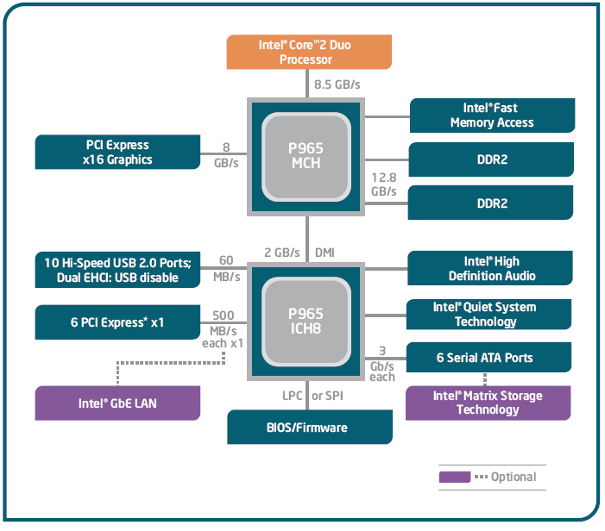
Intel 965 Express Chipset

Slide 21
Video Output
Video controller
on motherboard, or on expansion card
AGP (accelerated graphics port technology)*
Video memory (VRAM)
Video CRT Display
uses raster scanning
horizontal retrace
vertical retrace
Direct digital LCD monitors
no raster scanning required
* This link may change over time.

Slide 22
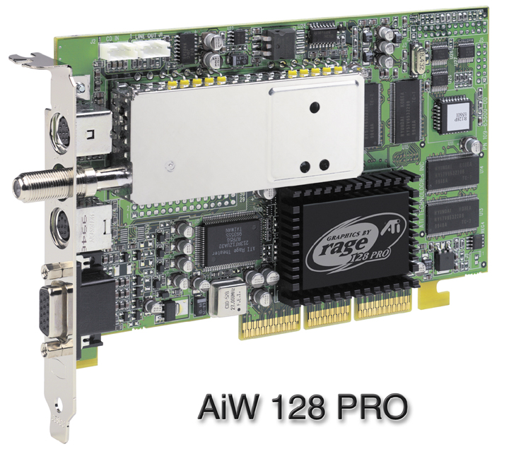
Sample Video Controller (ATI Corp.)
128-bit 3D graphics performance powered by RAGE™ 128 PRO
3D graphics performance
Intelligent TV-Tuner with Digital VCR
TV-ON-DEMAND™
Interactive Program Guide
Still image and MPEG-2 motion video capture
Video editing
Hardware DVD video playback
Video output to TV or VCR

Slide 23
Memory Hierarchy
Organized from the fastest to Slowest as follows
Cache inside CPU (fastest, most cost/bit, volatile, smallest)
Cache outside CPU
RAM/ROM
External Drive (SSD)
External Drive (Hard Drive)
Tape Drive (slowest, least cost/bit, non-volatile)

Slide 24
Cache Memory
High-speed expensive static RAM both inside and outside the CPU.
Level-1 cache: inside the CPU
Level-2 cache: outside the CPU
Cache hit: when data to be read is already in cache memory
Cache miss: when data to be read is not in cache memory.
Cache is effective if the hit ratio is very high. This is true of programs in general because of loops.

Slide 25
Memory
ROM
read-only memory
EPROM
erasable programmable read-only memory
Dynamic RAM (DRAM)
inexpensive; must be refreshed constantly. Slower than SRAM
Static RAM (SRAM)
expensive; used for cache memory; no refresh required but power must be on all the time.
Video RAM (VRAM)
dual ported; optimized for constant video refresh
CMOS RAM
complimentary metal-oxide semiconductor
system setup information. Eg. Real-time clock
See: Intel platform memory (Intel technology brief: link address may change)

Slide 26
Memory Devices
Hard Disk Drive (HDD). Based on electromechanical technology. Non volatile.
Speed: 2.9 – 12 milliseconds (ms)
SSD (Solid State Drive). Based on electronic technology, a type of EEPROM, essentially flash technology. Faster but more expensive than HDD. Non volatile but data can leak data. Current trend is 20 yrs at 185 degree F to 100 years at 77 degree F

Slide 27

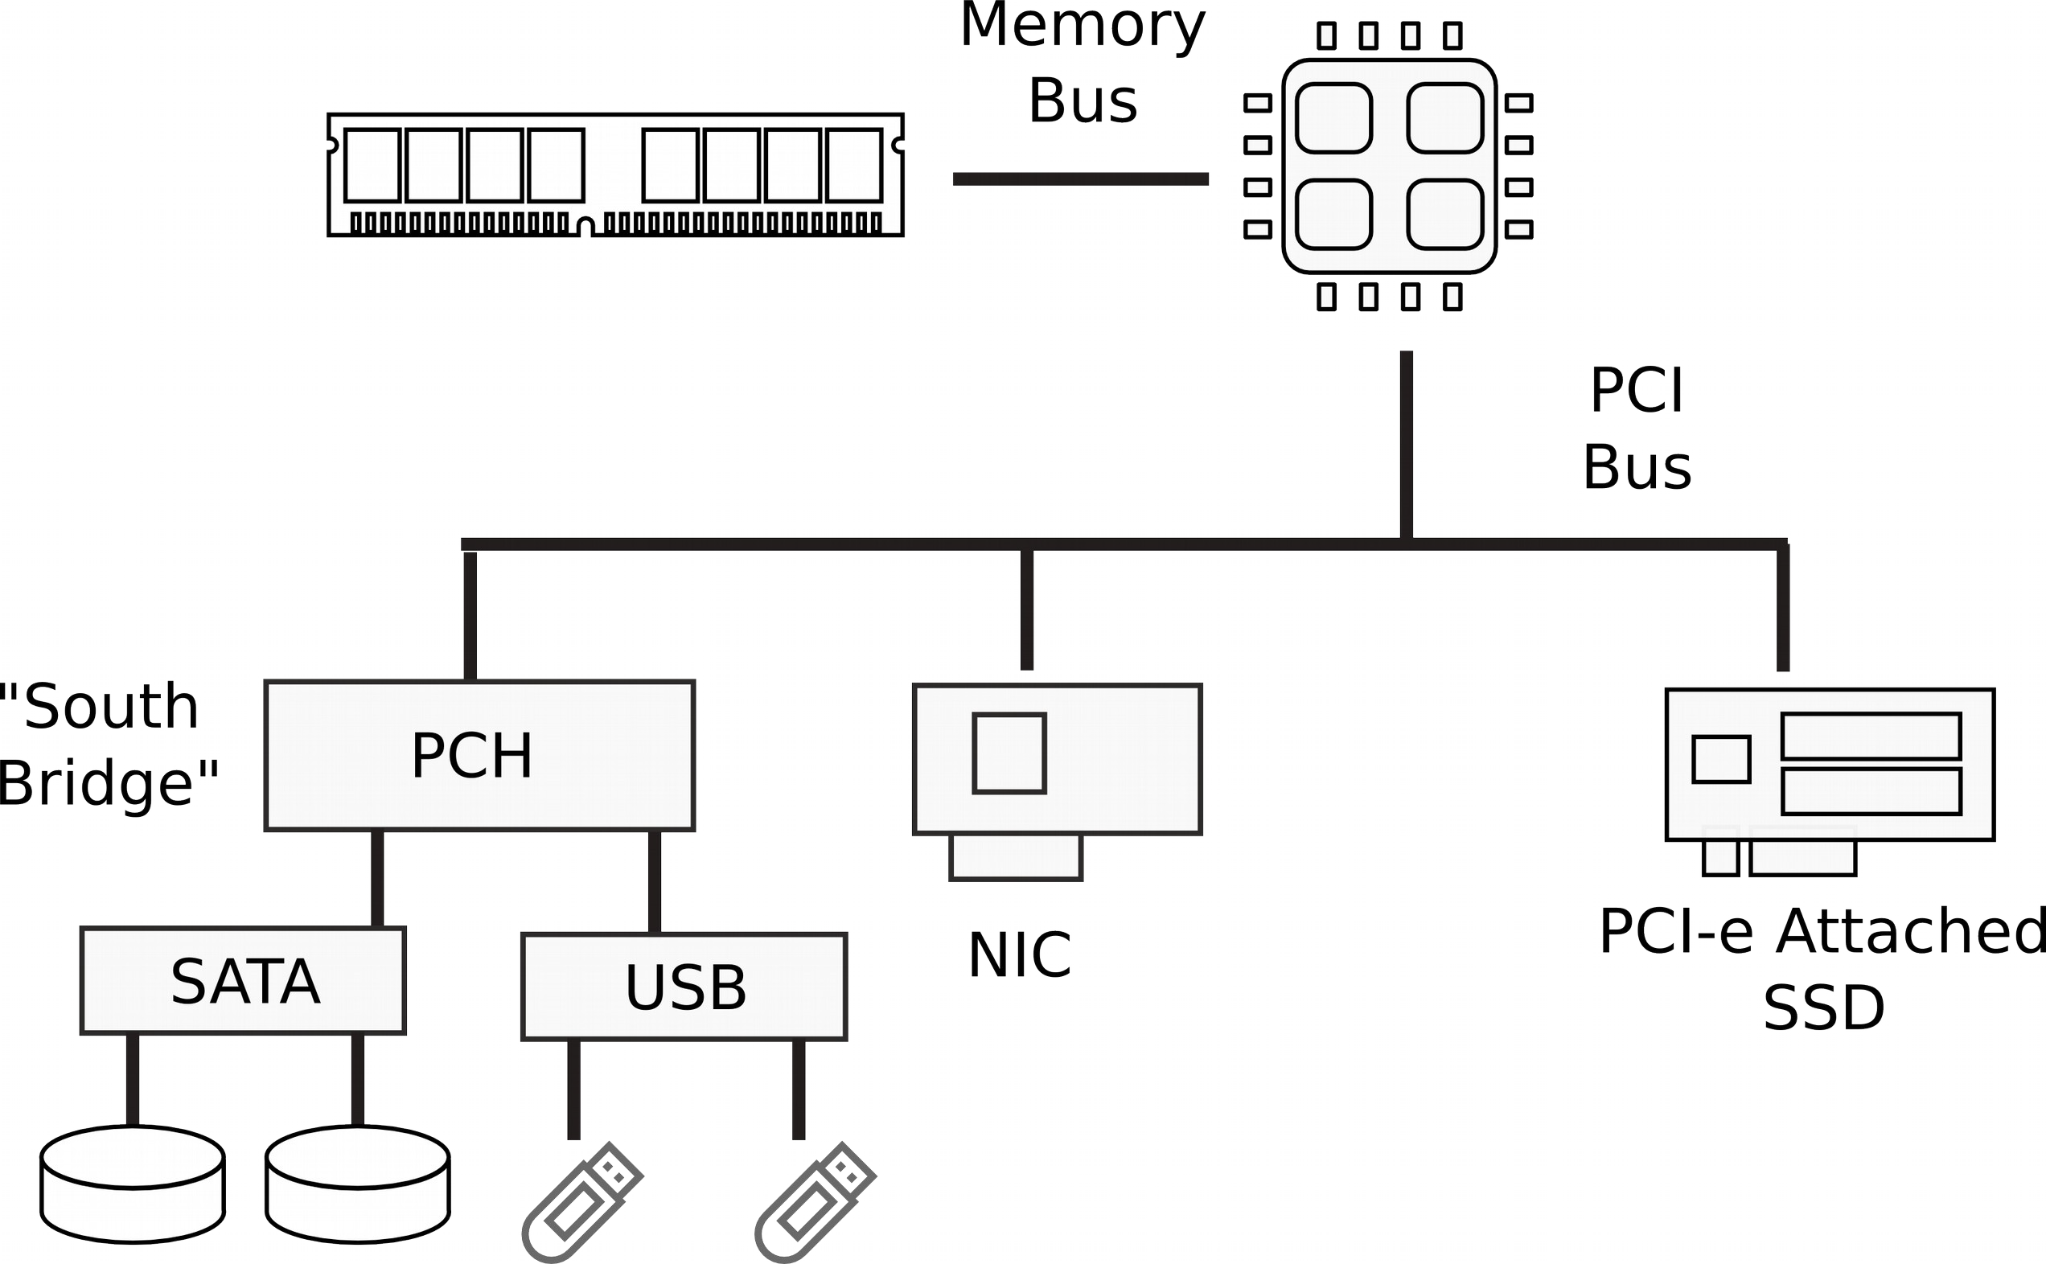
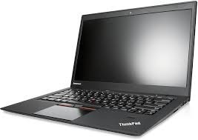
I/O Devices

Slide 28
Factors Affecting Input-Output (I/O) Devices
TECHNOLOGY: HDD is magnetic, DVD/CD is optical, KBD is mechanical, whereas MPU is electronic ➔ Hardware INTERFACE NEEDED
DATA TRANSFER RATE Differences ➔ Synchronization: Hardware/software concepts.
Programmed I/O – rare today unless absolutely needed
Interrupt I/O – KBD, mouse
Direct Memory Access (DMA) – HDD, NICs, etc

Slide 29
I/O Trends
CPU has n address lines, m data lines, and k control lines.
I/0 Devices interface is typically connected to a parallel bus to the CPU used to be connected with parallel lines (more recently printers)
Parallel require heavy expensive cables and physical connections to devices eg. Printers, kbd, etc.
Serial is uses 1 or sometimes 2 lines to transmit both (ie, address, data), extra lines for control, power and ground

Slide 30
I/O Trends 2
Trend is towards serial because it is more cost effective. Ie. More bits per second over long distance at lower cost. Eg. USB, USB-C, HDMI, Firewire, SATA, DVI
Even buses are moving towards serial.
PCI Express (PCIe)
Trend is towards Higher and Higher Speeds.
HDMI: 4.9 – 48 Gbps
USB: 1.5 Mbps (v1) – 10 Gbps (v3.1)

Slide 31
Input-Output Ports
USB (universal serial bus)
intelligent high-speed connection to devices
up to 12 megabits/second
USB hub connects multiple devices
enumeration: computer queries devices
supports hot connections
Parallel
short cable, high speed
common for printers
bidirectional, parallel data transfer
Intel 8255 controller chip

Slide 32
Input-Output Ports (cont)
Serial (OLD)
RS-232 serial port
one bit at a time
uses long cables and modems
16550 UART (universal asynchronous receiver transmitter)
programmable in assembly language

Slide 33
Device Interfaces
ATA host adapters
intelligent drive electronics (hard drive, CDROM)
SATA (Serial ATA)
inexpensive, fast, bidirectional
FireWire
high speed (800 MB/sec), many devices at once
Bluetooth
small amounts of data, short distances, low power usage
Wi-Fi (wireless Ethernet)
IEEE 802.11 standard, faster than Bluetooth

Slide 34
Generic IO System Interface
R/W#
Bus
Data
Address
External Decoder
I/O Port
CS
R/W#
Int Bus
MPU
Int Dcd
CntrR
StatusR
DataR
Register Select
I/O Device

Slide 35
How a Program Runs

Slide 36
IA-32 Processor Architecture
Modes of operation
Basic execution environment
Floating-point unit
Intel Microprocessor history

Slide 37
Modes of Operation
Protected mode
native mode (Windows NT and later, Linux)
Real-address mode
native MS-DOS, up to Windows ME
System management mode
power management, system security, diagnostics
Virtual-8086 mode
hybrid of Protected
each program has its own 8086 computer

Slide 38
Basic Execution Environment
Addressable memory
General-purpose registers
Index and base registers
Specialized register uses
Status flags
Floating-point, MMX, XMM registers

Slide 39
Addressable Memory
Protected mode
4 GB
32-bit address
Real-address and Virtual-8086 modes
1 MB space
20-bit address

Slide 40
Floating-Point, MMX, XMM Registers
Eight 80-bit floating-point data registers
ST(0), ST(1), . . . , ST(7)
arranged in a stack
used for all floating-point arithmetic
Eight 64-bit MMX registers
Eight 128-bit XMM registers for single-instruction multiple-data (SIMD) operations
SIMD = n processing elements (PE) with each PE performing the same operation on n data points simultaneously. Eg. Adjusting brightness in digital image or volume in audio. In general, vector operations using single instruction.

Slide 41
What's Next
General Concepts
IA-32 Processor Architecture
IA-32 Memory Management
64-Bit Processors
Components of an IA-32 Microcomputer
Input-Output System

Slide 42
IA-32 Memory Management
Real-address mode
Calculating linear addresses
Protected mode
Multi-segment model
Paging

Slide 43
Protected Mode (1 of 2)
4 GB addressable RAM
(00000000 to FFFFFFFFh)
Each program assigned a memory partition which is protected from other programs
Designed for multitasking
Supported by Linux & MS-Windows (NT and later)

Slide 44
What's Next
General Concepts
IA-32 Processor Architecture
IA-32 Memory Management
64-Bit Processors
Components of an IA-32 Microcomputer
Input-Output System

Slide 45
64-Bit Processors
64-Bit Operation Modes
Compatibility mode – can run existing 16-bit and 32-bit applications (Windows supports only 32-bit apps in this mode)
64-bit mode – Windows 64 uses this
Basic Execution Environment
addresses can be 64 bits (48 bits, in practice)
16 64-bit general purpose registers
64-bit instruction pointer named RIP

Slide 46
64-Bit General Purpose Registers
32-bit general purpose registers:
EAX, EBX, ECX, EDX, EDI, ESI, EBP, ESP, R8D, R9D, R10D, R11D, R12D, R13D, R14D, R15D
64-bit general purpose registers:
RAX, RBX, RCX, RDX, RDI, RSI, RBP, RSP, R8, R9, R10, R11, R12, R13, R14, R15

Slide 47
What's Next
General Concepts
IA-32 Processor Architecture
IA-32 Memory Management
64-Bit Processors
x86 Architecture Trends
Input-Output System

Slide 48
Computer Systems
●
Performance improvements:
Improvements in semiconductor technology
– Feature size, clock speed
Improvements in computer architectures
●
●
Enabled by high-level language compilers, general operating systems
Lead to RISC architectures
●
Together have enabled:
Lightweight computers
Productivity-based managed/interpreted programming languages
●
●

Slide 49
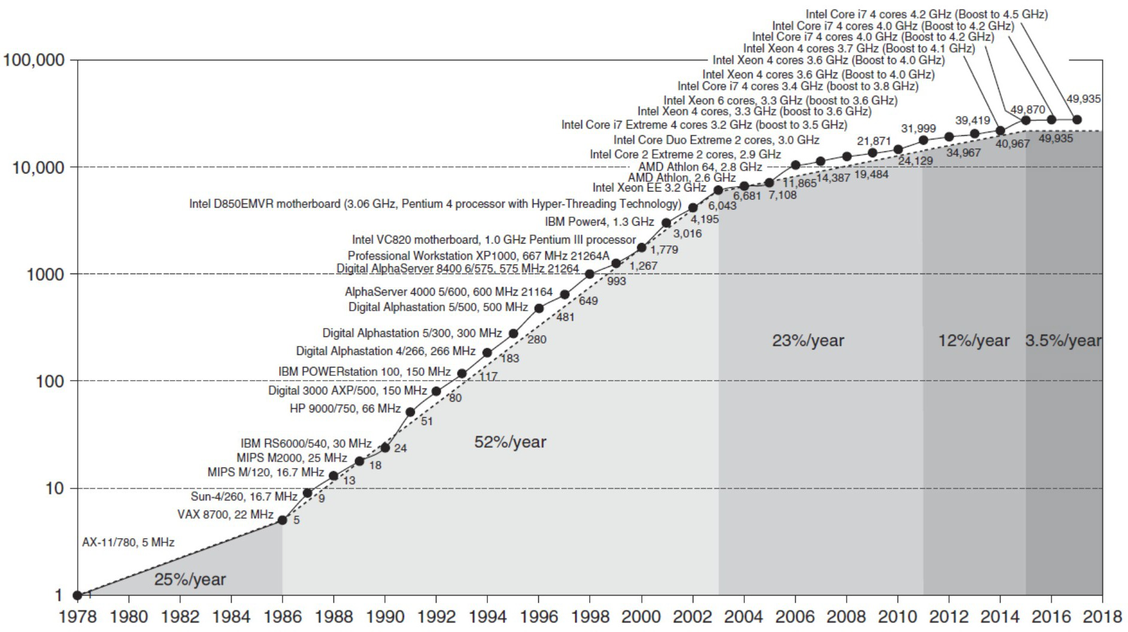
Single CPU on-chip performance

Slide 50
Points to note
●
The 52% growth per year is because of faster clock speeds and architectural innovations (led to 25x higher speed)
Clock speed increases have dropped to 1% per year in recent years
The 22% growth includes the parallelization from multiple cores
●
●
End of Moore’s Law: transistors on a chip double every 18-24 months
●
●

Slide 51
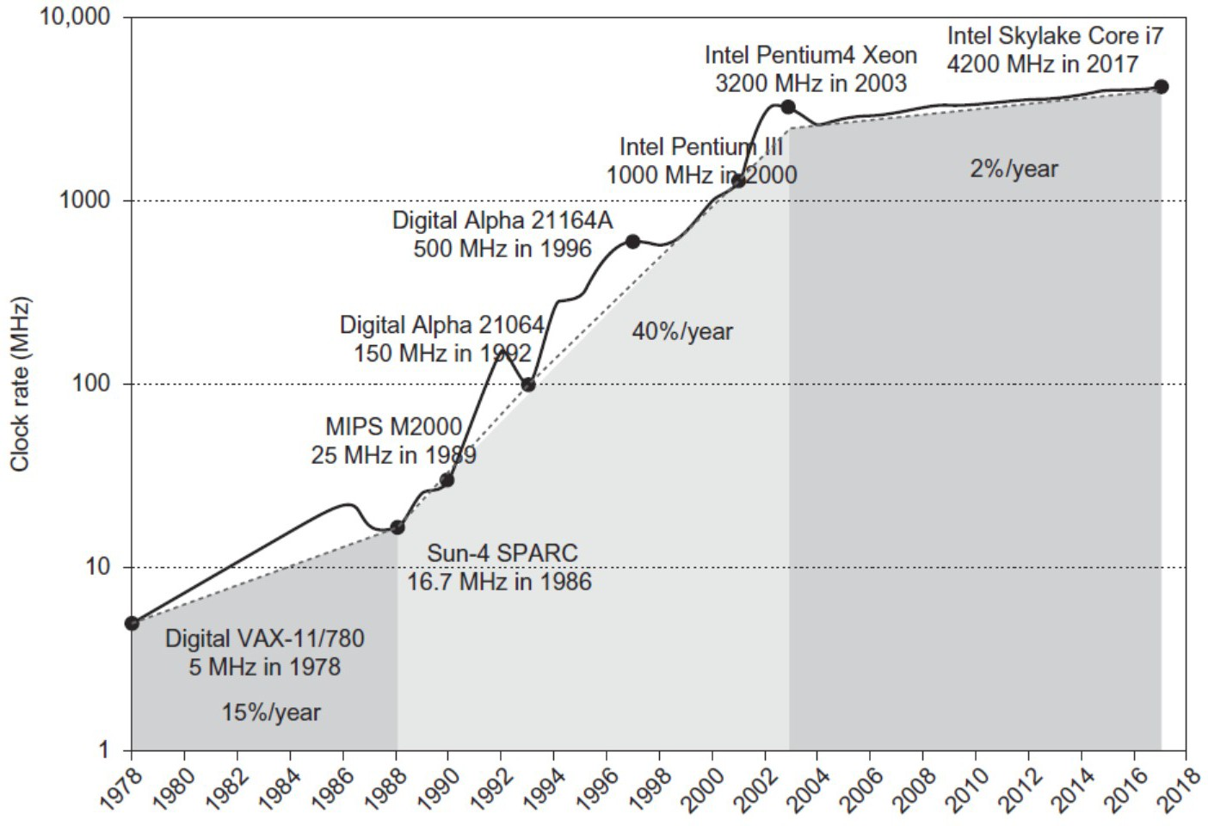
Clock speed growth

Slide 52
Current trends in architecture
●
Cannot continue to leverage Instruction-Level parallelism (ILP)
●
Single processor performance improvement ended in 2003
End of Moore’s Law
●

Slide 53
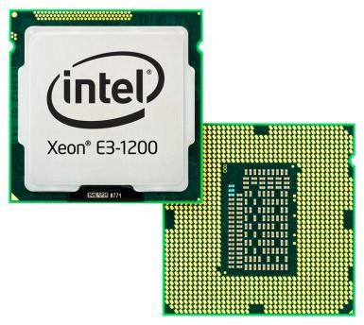
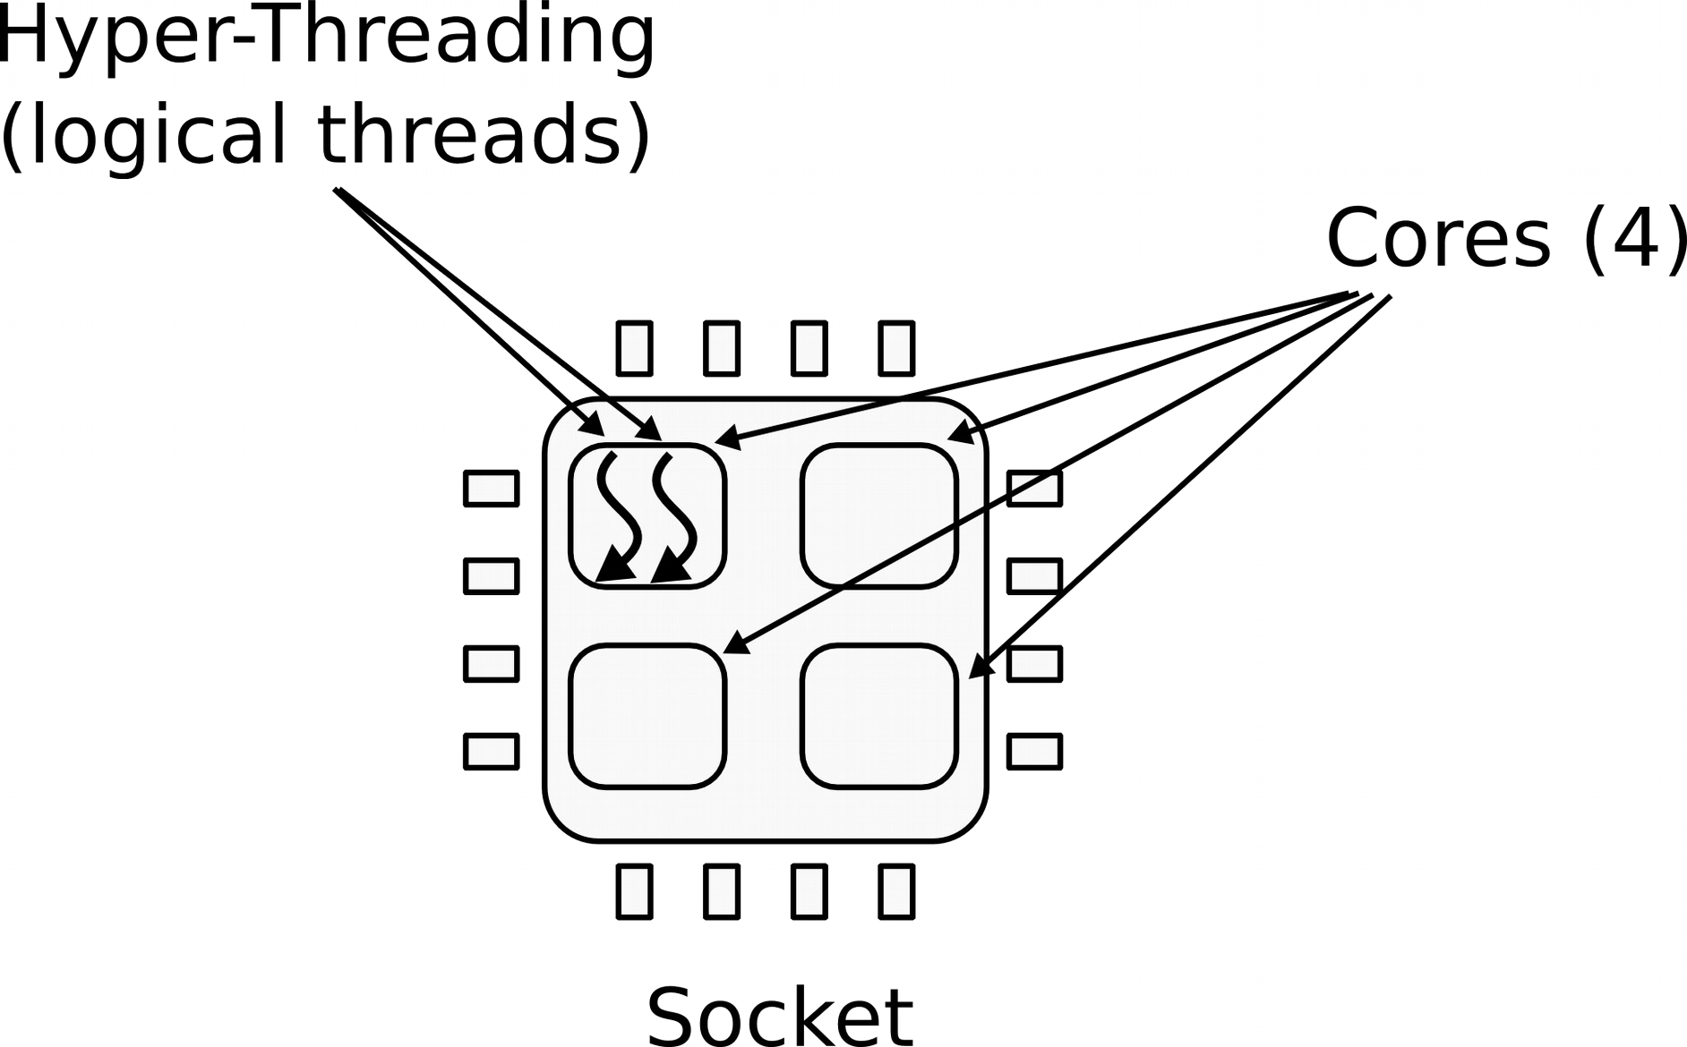
n CPUs in 1 Socket
●
1 CPU socket
4 cores
2 logical (HT) threads each
●

Slide 54
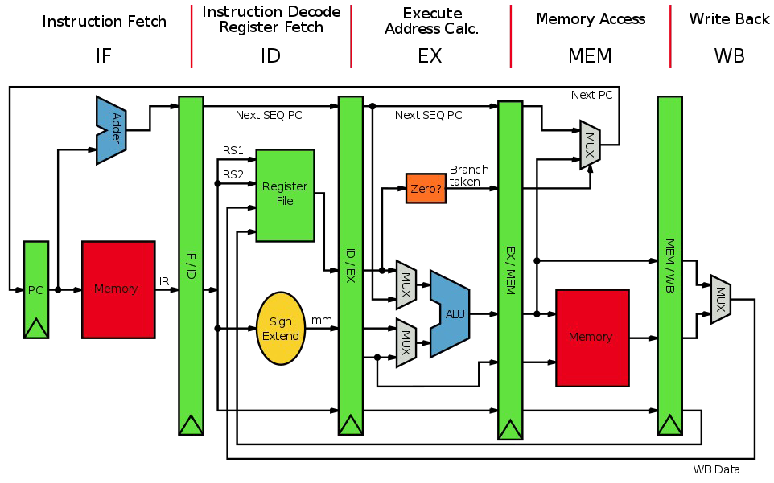
A simple 5-stage pipeline

Slide 55
What's Next
General Concepts
IA-32 Processor Architecture
IA-32 Memory Management
Components of an IA-32 Microcomputer
Input-Output System

Slide 56
Levels of Input-Output
Level 3: High-level language function
examples: C++, Java
portable, convenient, not always the fastest
Level 2: Operating system
Application Programming Interface (API)
extended capabilities, lots of details to master
Level 1: BIOS
drivers that communicate directly with devices
OS security may prevent application-level code from working at this level

Slide 57
Displaying a String of Characters
When a HLL program displays a string of characters, the following steps take place:

Slide 58
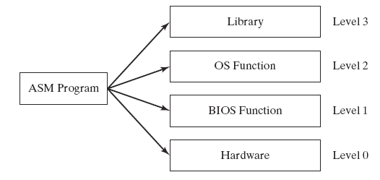
Programming levels
Assembly language programs can perform input-output at each of the following levels:

Slide 59
Summary
Central Processing Unit (CPU)
Arithmetic Logic Unit (ALU)
Instruction execution cycle
Multitasking
Floating Point Unit (FPU)
Complex Instruction Set
Real mode and Protected mode
Motherboard components
Memory types
Input/Output and access levels

Slide 60
The End

